Slide 1
Spin waves and magnons
Consider an almost perfectly ordered ferromagnet at low temperatures T<<T_{c}
At
magnetic moment characterized by spin:
z
J
y
x
Interaction between spins and magnetic field given by Hamiltonian
Spin waves:
Thermal properties of ferromagnet determined at T<<T_{c} by low
energy excitations, quantized spin waves
Strategy similar to photons and phonons
Phonons: classical dynamical problem provides correct eigenfrequencies of eigenmodes
classical spin wave dynamical problem provides correct eigenfrequencies of eigenmodes
With the dispersion relation for spin waves
Thermadynamics using quantized spin waves: magnons

Slide 2
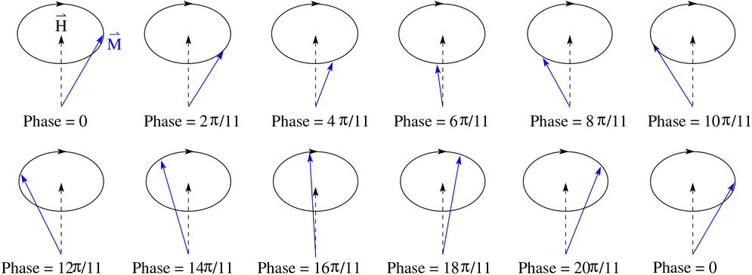
Derivation of spin waves in the classical limit
For simplicity let’s consider classical Heisenberg spin chain
J
J
Classical spin vectors S of length
Ground state : all spins parallel with energy
Deviations from ground state are spin wave excitations which can be pictured as
S

Slide 3
Deriving the spin wave dispersion relation
Spin is an angular momentum
Classical mechanics
Torque changes angular momentum
Here:
J
J
Exchange field, exchange interaction with neighbors can effectively be considered as a magnetic field acting on spin at position n

Slide 4
Let’s write down the x-component
the rest follows from cyclic permutation
(be careful with the signs though!)
We consider excitations with small amplitude
Takes care of the fact that spins are at discrete lattice positions x_{n}=n a
Solution with plane wave ansatz:

Slide 5
With
and
into
Non-trivial solution meaning other than u=v=0 for:
Magnon dispersion relation

Slide 6
Thermodynamics of magnons
Calculation of the internal energy:
in complete analogy to the photons
and phonons
We consider the limit T->0:
Only low energy magnons near k=0 excited
With
With
and hence

Slide 7
Just a number which becomes with integration to infinity
Exponent different than for phonons due to difference in dispersion

Slide 8
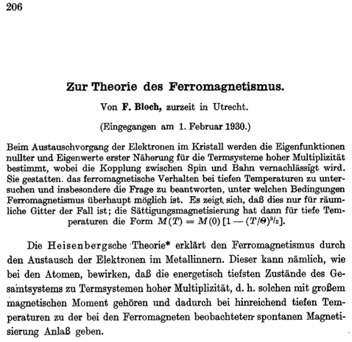
Z. Physik 61, 206 (1930):
Magnetization and the celebrated T^{3/2} Bloch law:
The internal energy
can alternatively be expressed as
where
Intuitive/hand-waving interpretation:
# of excitations in a mode <-> average of classical amplitude squared
Magnetization and its deviation from full alignment in z-direction is determined as

Slide 9
Let’s closer inspect
and remember
for T->0
with
using
and
Intuitive interpretation:
Excitation of spin waves (magnons) means spins point on average
less in z-direction -> magnetization goes down

Slide 10
Now let’s calculate M(T) with magnon dispersion at T->0
with
and
Again with
and hence
Felix Bloch (1905 - 1983)
Nobel Prize in 1952 for NMR

Slide 11
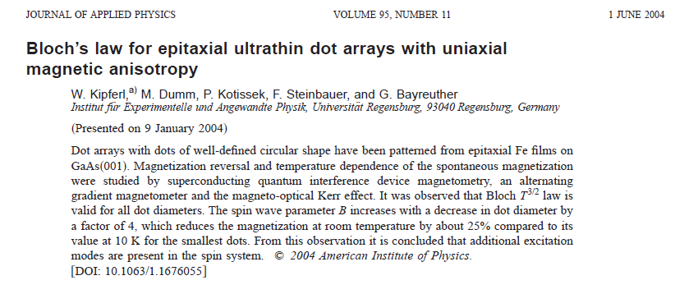
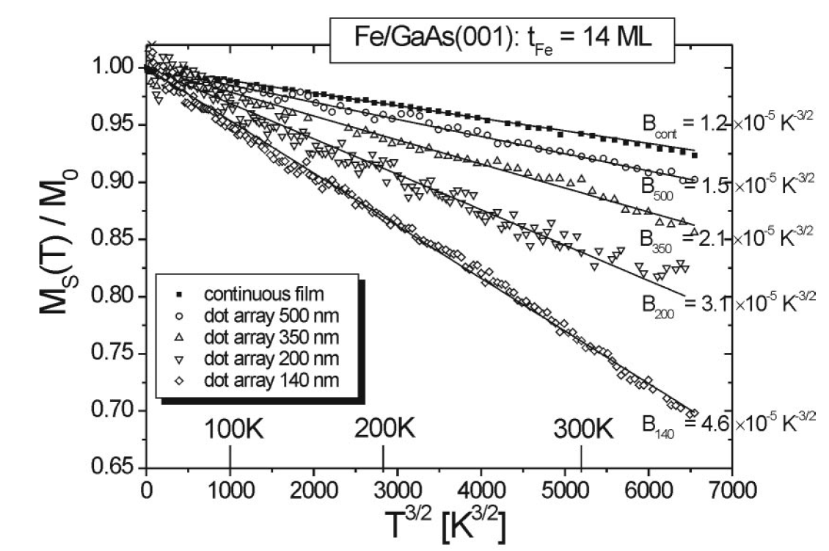
Modern research example:
Bloch’s T^{3/2}-law widely applicable also in exotic systems

Slide 12
Spin waves and phase transitions: Goldstone excitations
A stability analysis against long wavelength fluctuations gives hints for the possible existence of a long range ordered phase
Heisenberg Hamiltonian example for continuous rotational symmetry which can be spontaneously broken depending on the dimension, d
When a continuous symmetry is broken there must exist
a Goldstone mode (boson) with ω→0 for k→0
d=1
d=2
Let’s have a look to spin wave approach for
in various spatial dimensions d
From
and
In low dimensions d=1 and d=2 integral diverges at the lower bound k=0
Unphysical result indicates absence of ordered
low temperature phase in d=1 and d=2

